Slide 1
CSE 2201 Design and Analysis of Algorithms – I Lecture 1 BFS & DFS (Review)
Hasnain Heickal
Assistant Professor
Department of CSE, University of Dhaka

Slide 2
Complexity
Time
Memory
Coding

Slide 3
Time complexity
Amount of time needed for the algorithm to finish
Best case
Average case
Worst case
Not actual time: related to size of input.
Big O notation

Slide 4
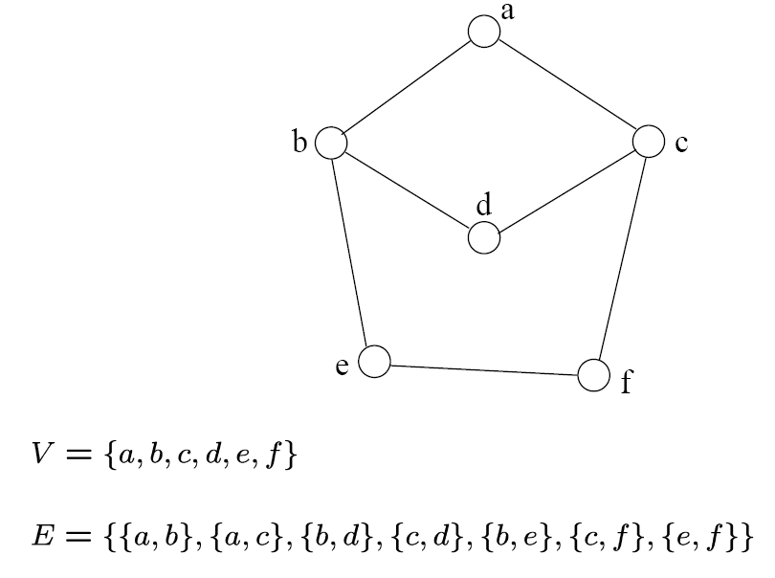
Graph - Definition
A graph G=(V, E) consists a set of vertices, V, and a set of edges, E.
Each edge is a pair of (v, w), where v, w belongs to V
If the pair is unordered, the graph is undirected; otherwise it is directed
{a,b}
{a,c}
{b,d}
{c,d}
{b,e}
{c,f}
{e,f}
An undirected graph

Slide 5
Definition
Complete Graph
How many edges are there in an N-vertex complete graph?
Bipartite Graph
What is its property? How can we detect it?
Path
Degree of a vertices
Indegree
Outdegree
Indegree+outdegree = Even (why??)

Slide 6
Graph Variations
Variations:
A connected graph has a path from every vertex to every other
In an undirected graph:
Edge (u,v) = edge (v,u)
No self-loops
In a directed graph:
Edge (u,v) goes from vertex u to vertex v, notated u→v

Slide 7
Graph Variations
More variations:
A weighted graph associates weights with either the edges or the vertices
E.g., a road map: edges might be weighted w/ distance
A multigraph allows multiple edges between the same vertices
E.g., the call graph in a program (a function can get called from multiple points in another function)

Slide 8
Graphs
We will typically express running times in terms of |E| and |V| (often dropping the |’s)
If |E| ≈ |V|² the graph is dense
If |E| ≈ |V| the graph is sparse
If you know you are dealing with dense or sparse graphs, different data structures may make sense

Slide 9
Graph Representation
Two popular computer representations of a graph. Both represent the vertex set and the edge set, but in different ways.
Adjacency Matrix
Use a 2D matrix to represent the graph
Adjacency List
Use a 1D array of linked lists (We will implement it using vector in c++)

Slide 10
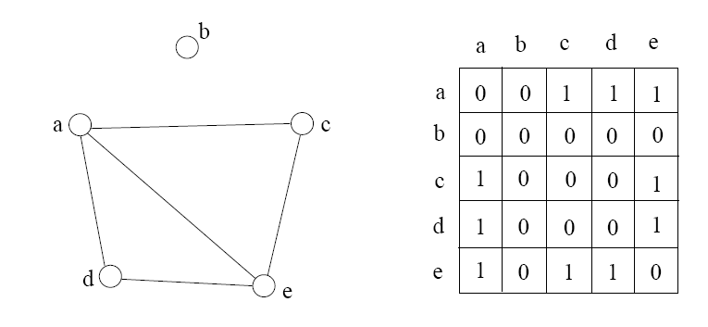
Adjacency Matrix
2D array A[0..n-1, 0..n-1], where n is the number of vertices in the graph
Each row and column is indexed by the vertex id
e,g a=0, b=1, c=2, d=3, e=4
A[i][j]=1 if there is an edge connecting vertices i and j; otherwise, A[i][j]=0
The storage requirement is Θ(n²). It is not efficient if the graph has few edges. An adjacency matrix is an appropriate representation if the graph is dense: |E|=Θ(|V|²)
We can detect in O(1) time whether two vertices are connected.

Slide 11
Simple Questions on Adjacency Matrix
Is there a direct link between A and B?
What is the indegree and outdegree for a vertex A?
How many nodes are directly connected to vertex A?
Is it an undirected graph or directed graph?
Suppose ADJ is an NxN matrix. What will be the result if we create another matrix ADJ2 where ADJ2=ADJxADJ?

Slide 12
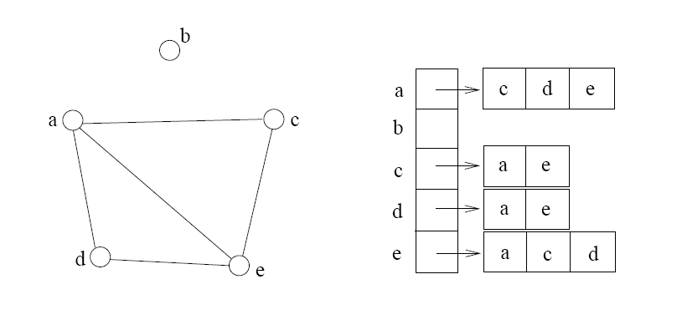
Adjacency List
If the graph is not dense, in other words, sparse, a better solution is an adjacency list
The adjacency list is an array A[0..n-1] of lists, where n is the number of vertices in the graph.
Each array entry is indexed by the vertex id
Each list A[i] stores the ids of the vertices adjacent to vertex i

Slide 13
Adjacency Matrix Example
0
 | 0 | 1 | 2 | 3 | 4 | 5 | 6 | 7 | 8 | 9
0 | 0 | 0 | 0 | 0 | 0 | 0 | 0 | 0 | 1 | 0
1 | 0 | 0 | 1 | 1 | 0 | 0 | 0 | 1 | 0 | 1
2 | 0 | 1 | 0 | 0 | 1 | 0 | 0 | 0 | 1 | 0
3 | 0 | 1 | 0 | 0 | 1 | 1 | 0 | 0 | 0 | 0
4 | 0 | 0 | 1 | 1 | 0 | 0 | 0 | 0 | 0 | 0
5 | 0 | 0 | 0 | 1 | 0 | 0 | 1 | 0 | 0 | 0
6 | 0 | 0 | 0 | 0 | 0 | 1 | 0 | 1 | 0 | 0
7 | 0 | 1 | 0 | 0 | 0 | 0 | 1 | 0 | 0 | 0
8 | 1 | 0 | 1 | 0 | 0 | 0 | 0 | 0 | 0 | 1
9 | 0 | 1 | 0 | 0 | 0 | 0 | 0 | 0 | 1 | 0
8
2
9
1
3
7
6
4
5

Slide 14
Adjacency List Example
0
0
1
2
3
4
5
6
7
8
9
8
2 | 3 | 7 | 9
8
1 | 4 | 8
2
9
1 | 4 | 5
1
2 | 3
7
3 | 6
3
6
5 | 7
4
5
1 | 6
0 | 2 | 9
1 | 8

Slide 15
Storage of Adjacency List
The array takes up Θ(n) space
Define degree of v, deg(v), to be the number of edges incident to v. Then, the total space to store the graph is proportional to:
An edge e={u,v} of the graph contributes a count of 1 to deg(u) and contributes a count 1 to deg(v)
Therefore, Σ_{vertex v}deg(v) = 2m, where m is the total number of edges
In all, the adjacency list takes up Θ(n+m) space
If m = O(n²) (i.e. dense graphs), both adjacent matrix and adjacent lists use Θ(n²) space.
If m = O(n), adjacent list outperform adjacent matrix
However, one cannot tell in O(1) time whether two vertices are connected

Slide 16
Adjacency List vs. Matrix
Adjacency List
More compact than adjacency matrices if graph has few edges
Requires more time to find if an edge exists
Adjacency Matrix
Always require n² space
This can waste a lot of space if the number of edges are sparse
Can quickly find if an edge exists

Slide 17
Path between Vertices
A path is a sequence of vertices (v₀, v₁, v₂,… v_{k}) such that:
For 0 ≤ i < k, {v_{i}, v_{i+1}} is an edge
Note: a path is allowed to go through the same vertex or the same edge any number of times!
The length of a path is the number of edges on the path

Slide 18
Types of paths
A path is simple if and only if it does not contain a vertex more than once.
A path is a cycle if and only if v₀= v_{k}
The beginning and end are the same vertex!
A path contains a cycle as its sub-path if some vertex appears twice or more

Slide 19
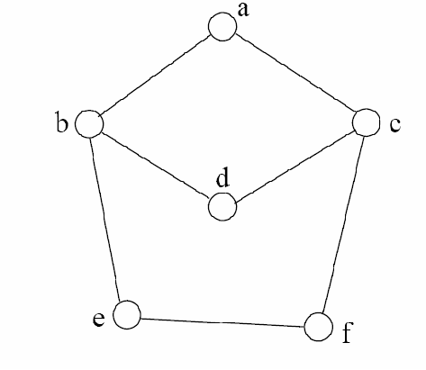
Path Examples
Are these paths?
Any cycles?
What is the path’s length?
{a,c,f,e}
{a,b,d,c,f,e}
{a, c, d, b, d, c, f, e}
{a,c,d,b,a}
{a,c,f,e,b,d,c,a}

Slide 20
Exercises on Graph
CLRS – Chapter 22 – elementary Graph Algorithms
Exercise you have to solve: (Page 593)
22.1-5 (Square)
22.1-6 (Universal Sink)

Slide 21
Graph Traversal
Application example
Given a graph representation and a vertex s in the graph
Find paths from s to other vertices
Two common graph traversal algorithms
Breadth-First Search (BFS)
Find the shortest paths in an unweighted graph
Depth-First Search (DFS)
Topological sort
Find strongly connected components

Slide 22
BFS and Shortest Path Problem
Given any source vertex s, BFS visits the other vertices at increasing distances away from s. In doing so, BFS discovers paths from s to other vertices
What do we mean by “distance”? The number of edges on a path from s
Example
0
Consider s=vertex 1
8
2
Nodes at distance 1?
2, 3, 7, 9
1
2
s
9
1
1
Nodes at distance 2?
8, 6, 5, 4
7
1
3
6
2
4
1
5
Nodes at distance 3?
0
2
2

Slide 23
Graph Searching
Given: a graph G = (V, E), directed or undirected
Goal: methodically explore every vertex and every edge
Ultimately: build a tree on the graph
Pick a vertex as the root
Choose certain edges to produce a tree
Note: might also build a forest if graph is not connected

Slide 24
Breadth-First Search
“Explore” a graph, turning it into a tree
One vertex at a time
Expand frontier of explored vertices across the breadth of the frontier
Builds a tree over the graph
Pick a source vertex to be the root
Find (“discover”) its children, then their children, etc.

Slide 25
Breadth-First Search
Every vertex of a graph contains a color at every moment:
White vertices have not been discovered
All vertices start with white initially
Grey vertices are discovered but not fully explored
They may be adjacent to white vertices
Black vertices are discovered and fully explored
They are adjacent only to black and gray vertices
Explore vertices by scanning adjacency list of grey vertices

Slide 26
Breadth-First Search: The Code
Data: color[V], prev[V],d[V]
BFS(G) // starts from here
{
for each vertex u ∈ V-{s}
{
color[u]=WHITE;
prev[u]=NIL;
d[u]=inf;
}
color[s]=GRAY;
d[s]=0; prev[s]=NIL;
Q=empty;
ENQUEUE(Q,s);
While(Q not empty)
{
u = DEQUEUE(Q);
for each v ∈ adj[u]{
if (color[v] == WHITE){
color[v] = GREY;
d[v] = d[u] + 1;
prev[v] = u;
Enqueue(Q, v);
}
}
color[u] = BLACK;
}
}

Slide 27
Breadth-First Search: Example
r
s
t
u
∞
∞
∞
∞
∞
∞
∞
∞
v
w
x
y
Vertex | r | s | t | u | v | w | x | y
color | W | W | W | W | W | W | W | W
d | ∞ | ∞ | ∞ | ∞ | ∞ | ∞ | ∞ | ∞
prev | nil | nil | nil | nil | nil | nil | nil | nil

Slide 28
Breadth-First Search: Example
r
s
t
u
∞
0
∞
∞
∞
∞
∞
∞
v
w
x
y
Q:
s
vertex | r | s | t | u | v | w | x | y
Color | W | G | W | W | W | W | W | W
d | ∞ | 0 | ∞ | ∞ | ∞ | ∞ | ∞ | ∞
prev | nil | nil | nil | nil | nil | nil | nil | nil

Slide 29
Breadth-First Search: Example
r
s
t
u
1
0
∞
∞
∞
1
∞
∞
v
w
x
y
Q:
s
w
r
vertex | r | s | t | u | v | w | x | y
Color | G | B | W | W | W | G | W | W
d | 1 | 0 | ∞ | ∞ | ∞ | 1 | ∞ | ∞
prev | s | nil | nil | nil | nil | s | nil | nil

Slide 30
Breadth-First Search: Example
r
s
t
u
1
0
2
∞
∞
1
2
∞
v
w
x
y
Q:
s
w
r
t
x
vertex | r | s | t | u | V | w | X | y
Color | G | B | G | W | W | B | G | W
d | 1 | 0 | 2 | ∞ | ∞ | 1 | 2 | ∞
prev | s | nil | w | nil | nil | s | w | nil

Slide 31
Breadth-First Search: Example
r
s
t
u
1
0
2
∞
2
1
2
∞
v
w
x
y
Q:
s
w
r
t
x
v
vertex | r | s | t | u | v | w | x | y
Color | B | B | G | W | G | B | G | W
d | 1 | 0 | 2 | ∞ | 2 | 1 | 2 | ∞
prev | s | nil | w | nil | r | s | w | nil

Slide 32
Breadth-First Search: Example
r
s
t
u
1
0
2
3
2
1
2
∞
v
w
x
y
Q:
s
w
r
t
x
v
u
vertex | r | s | t | u | v | w | x | y
Color | B | B | B | G | G | B | G | W
d | 1 | 0 | 2 | 3 | 2 | 1 | 2 | ∞
prev | s | nil | w | t | r | s | w | nil

Slide 33
Breadth-First Search: Example
r
s
t
u
1
0
2
3
2
1
2
3
v
w
x
y
Q:
s
w
r
t
x
v
u
y
vertex | r | s | t | u | v | w | x | y
Color | B | B | B | G | G | B | B | G
d | 1 | 0 | 2 | 3 | 2 | 1 | 2 | 3
prev | s | nil | w | t | r | s | w | x

Slide 34
Breadth-First Search: Example
r
s
t
u
1
0
2
3
2
1
2
3
v
w
x
y
Q:
s
w
r
t
x
v
u
y
vertex | r | s | t | u | v | w | x | y
Color | B | B | B | G | B | B | B | G
d | 1 | 0 | 2 | 3 | 2 | 1 | 2 | 3
prev | s | nil | w | t | r | s | w | x

Slide 35
Breadth-First Search: Example
r
s
t
u
1
0
2
3
2
1
2
3
v
w
x
y
Q:
s
w
r
t
x
v
u
y
vertex | r | s | t | u | v | w | x | y
Color | B | B | B | B | B | B | B | G
d | 1 | 0 | 2 | 3 | 2 | 1 | 2 | 3
prev | s | nil | w | t | r | s | w | x

Slide 36
Breadth-First Search: Example
r
s
t
u
1
0
2
3
2
1
2
3
v
w
x
y
Q:
s
w
r
t
x
v
u
y
vertex | r | s | t | u | v | w | x | y
Color | B | B | B | G | B | B | B | B
d | 1 | 0 | 2 | 3 | 2 | 1 | 2 | 3
prev | s | nil | w | t | r | s | w | x

Slide 37
BFS: The Code (again)
Data: color[V], prev[V],d[V]
BFS(G) // starts from here
{
for each vertex u ∈ V-{s}
{
color[u]=WHITE;
prev[u]=NIL;
d[u]=inf;
}
color[s]=GRAY;
d[s]=0; prev[s]=NIL;
Q=empty;
ENQUEUE(Q,s);
While(Q not empty)
{
u = DEQUEUE(Q);
for each v ∈ adj[u]{
if (color[v] == WHITE){
color[v] = GREY;
d[v] = d[u] + 1;
prev[v] = u;
Enqueue(Q, v);
}
}
color[u] = BLACK;
}
}

Slide 38
Breadth-First Search: Print Path
Data: color[V], prev[V],d[V]
Print-Path(G, s, v)
{
if(v==s)
print(s)
else if(prev[v]==NIL)
print(No path);
else{
Print-Path(G,s,prev[v]);
print(v);
}
}

Slide 39
Amortized Analysis
Queue with 3 operations:
Push, Pop, Multi-pop
What will be the complexity if “n” operations are performed?

Slide 40
BFS: Complexity
Data: color[V], prev[V],d[V]
BFS(G) // starts from here
{
for each vertex u ∈ V-{s}
{
color[u]=WHITE;
prev[u]=NIL;
d[u]=inf;
}
color[s]=GRAY;
d[s]=0; prev[s]=NIL;
Q=empty;
ENQUEUE(Q,s);
While(Q not empty)
{
u = DEQUEUE(Q);
for each v ∈ adj[u]{
if(color[v] == WHITE){
color[v] = GREY;
d[v] = d[u] + 1;
prev[v] = u;
Enqueue(Q, v);
}
}
color[u] = BLACK;
}
}
u = every vertex, but only once (Why?)
O(V)
O(V)
What will be the running time?
Total running time: O(V+E)

Slide 41
Breadth-First Search: Properties
BFS calculates the shortest-path distance to the source node
Shortest-path distance δ(s,v) = minimum number of edges from s to v, or ∞ if v not reachable from s
Proof given in the book (p. 472-5)
BFS builds breadth-first tree, in which paths to root represent shortest paths in G
Thus can use BFS to calculate shortest path from one vertex to another in O(V+E) time

Slide 42
Application of BFS
Find the shortest path in an undirected/directed unweighted graph.
Find the bipartite-ness of a graph.
Find cycle in a graph.
Find the connectedness of a graph.
And many more.

Slide 43
Exercises on BFS
CLRS – Chapter 22 – elementary Graph Algorithms
Exercise you have to solve: (Page 602)
22.2-7 (Wrestler)
22.2-8 (Diameter)
22.2-9 (Traverse)

Slide 44
Depth-First Search
Input:
G = (V, E) (No source vertex given!)
Goal:
Explore the edges of G to “discover” every vertex in V starting at the most current visited node
Search may be repeated from multiple sources
Output:
2 timestamps on each vertex:
d[v] = discovery time
f[v] = finishing time (done with examining v’s adjacency list)
Depth-first forest
1
2
3
5
4

Slide 45
Depth-First Search
Search “deeper” in the graph whenever possible
Edges are explored out of the most recently discovered vertex v that still has unexplored edges
2
1
3
5
4
After all edges of v have been explored, the search “backtracks” from the parent of v
The process continues until all vertices reachable from the original source have been discovered
If undiscovered vertices remain, choose one of them as a new source and repeat the search from that vertex
DFS creates a “depth-first forest”

Slide 46
DFS Additional Data Structures
Global variable: time-stamp
Incremented when nodes are discovered or finished
color[u] – similar to BFS
White before discovery, gray while processing and black when finished processing
prev[u] – predecessor of u
d[u], f[u] – discovery and finish times
1 ≤ d[u] < f [u] ≤ 2 |V|
WHITE
GRAY
BLACK
0
d[u]
f[u]
2V

Slide 47
Depth-First Search: The Code
Data: color[V], time, prev[V],d[V], f[V]
DFS(G) // where prog starts
{
for each vertex u ∈ V
{
color[u] = WHITE;
prev[u]=NIL;
f[u]=inf; d[u]=inf;
}
time = 0;
for each vertex u ∈ V
if (color[u] == WHITE)
DFS_Visit(u);
}
DFS_Visit(u)
{
color[u] = GREY;
time = time+1;
d[u] = time;
for each v ∈ Adj[u]
{
if(color[v] == WHITE){
prev[v]=u;
DFS_Visit(v);}
}
color[u] = BLACK;
time = time+1;
f[u] = time;
}
Initialize

Slide 48
Depth-First Search: The Code
Data: color[V], time, prev[V],d[V], f[V]
DFS(G) // where prog starts
{
for each vertex u ∈ V
{
color[u] = WHITE;
prev[u]=NIL;
f[u]=inf; d[u]=inf;
}
time = 0;
for each vertex u ∈ V
if (color[u] == WHITE)
DFS_Visit(u);
}
DFS_Visit(u)
{
color[u] = GREY;
time = time+1;
d[u] = time;
for each v ∈ Adj[u]
{
if(color[v] == WHITE){
prev[v]=u;
DFS_Visit(v);}
}
color[u] = BLACK;
time = time+1;
f[u] = time;
}
What does d[u] represent?

Slide 49
Depth-First Search: The Code
Data: color[V], time, prev[V],d[V], f[V]
DFS(G) // where prog starts
{
for each vertex u ∈ V
{
color[u] = WHITE;
prev[u]=NIL;
f[u]=inf; d[u]=inf;
}
time = 0;
for each vertex u ∈ V
if (color[u] == WHITE)
DFS_Visit(u);
}
DFS_Visit(u)
{
color[u] = GREY;
time = time+1;
d[u] = time;
for each v ∈ Adj[u]
{
if(color[v] == WHITE){
prev[v]=u;
DFS_Visit(v);}
}
color[u] = BLACK;
time = time+1;
f[u] = time;
}
What does f[u] represent?

Slide 50
Depth-First Search: The Code
Data: color[V], time, prev[V],d[V], f[V]
DFS(G) // where prog starts
{
for each vertex u ∈ V
{
color[u] = WHITE;
prev[u]=NIL;
f[u]=inf; d[u]=inf;
}
time = 0;
for each vertex u ∈ V
if (color[u] == WHITE)
DFS_Visit(u);
}
DFS_Visit(u)
{
color[u] = GREY;
time = time+1;
d[u] = time;
for each v ∈ Adj[u]
{
if(color[v] == WHITE){
prev[v]=u;
DFS_Visit(v);
}}
color[u] = BLACK;
time = time+1;
f[u] = time;
}
Will all vertices eventually be colored black?

Slide 51
DFS Example
source vertex
S
D
F
A
E
B
C
G

Slide 52
DFS Example
source vertex
d f
F
S
D
1 |
|
|
A
|
|
E
|
|
|
B
C
G

Slide 53
DFS Example
source vertex
d f
F
S
D
1 |
|
|
A
2 |
|
E
|
|
|
B
C
G

Slide 54
DFS Example
source vertex
d f
F
S
D
1 |
|
|
A
2 |
|
E
3 |
|
|
B
C
G

Slide 55
DFS Example
source vertex
d f
F
S
D
1 |
|
|
A
2 |
|
E
3 | 4
|
|
B
C
G

Slide 56
DFS Example
source vertex
d f
F
S
D
1 |
|
|
A
2 |
|
E
3 | 4
5 |
|
B
C
G

Slide 57
DFS Example
source vertex
d f
F
S
D
1 |
|
|
A
2 |
|
E
3 | 4
5 | 6
|
B
C
G

Slide 58
DFS Example
source vertex
d f
F
S
D
1 |
|
|
A
2 | 7
|
E
3 | 4
5 | 6
|
B
C
G

Slide 59
DFS Example
source vertex
d f
F
S
D
1 |
8 |
|
A
2 | 7
|
E
3 | 4
5 | 6
|
B
C
G

Slide 60
DFS Example
source vertex
d f
F
S
D
1 |
8 |
|
A
2 | 7
9 |
E
3 | 4
5 | 6
|
B
C
G
What is the structure of the grey vertices? What do they represent?

Slide 61
DFS Example
source vertex
d f
F
S
D
1 |
8 |
|
A
2 | 7
9 |10
E
3 | 4
5 | 6
|
B
C
G

Slide 62
DFS Example
source vertex
d f
F
S
D
1 |
8 |11
|
A
2 | 7
9 |10
E
3 | 4
5 | 6
|
B
C
G

Slide 63
DFS Example
source vertex
d f
F
S
D
1 |12
8 |11
|
A
2 | 7
9 |10
E
3 | 4
5 | 6
|
B
C
G

Slide 64
DFS Example
source vertex
d f
F
S
D
1 |12
8 |11
13|
A
2 | 7
9 |10
E
3 | 4
5 | 6
|
B
C
G

Slide 65
DFS Example
source vertex
d f
F
S
D
1 |12
8 |11
13|
A
2 | 7
9 |10
E
3 | 4
5 | 6
14|
B
C
G

Slide 66
DFS Example
source vertex
d f
F
S
D
1 |12
8 |11
13|
A
2 | 7
9 |10
E
3 | 4
5 | 6
14|15
B
C
G

Slide 67
DFS Example
source vertex
d f
F
S
D
1 |12
8 |11
13|16
A
2 | 7
9 |10
E
3 | 4
5 | 6
14|15
B
C
G

Slide 68
Depth-First Search: The Code
Data: color[V], time, prev[V],d[V], f[V]
DFS(G) // where prog starts
{
for each vertex u ∈ V
{
color[u] = WHITE;
prev[u]=NIL;
f[u]=inf; d[u]=inf;
}
time = 0;
for each vertex u ∈ V
if (color[u] == WHITE)
DFS_Visit(u);
}
DFS_Visit(u)
{
color[u] = GREY;
time = time+1;
d[u] = time;
for each v ∈ Adj[u]
{
if (color[v] == WHITE)
prev[v]=u;
DFS_Visit(v);
}
color[u] = BLACK;
time = time+1;
f[u] = time;
}
What will be the running time?

Slide 69
Depth-First Search: The Code
Data: color[V], time, prev[V],d[V], f[V]
DFS(G) // where prog starts
{
for each vertex u ∈ V
{
color[u] = WHITE;
prev[u]=NIL;
f[u]=inf; d[u]=inf;
}
time = 0;
for each vertex u ∈ V
if (color[u] == WHITE)
DFS_Visit(u);
}
DFS_Visit(u)
{
color[u] = GREY;
time = time+1;
d[u] = time;
for each v ∈ Adj[u]
{
if (color[v] == WHITE)
prev[v]=u;
DFS_Visit(v);
}
color[u] = BLACK;
time = time+1;
f[u] = time;
}
O(V)
O(V)
O(V)
Running time: O(V²) because call DFS_Visit on each vertex, and the loop over Adj[] can run as many as |V| times

Slide 70
Depth-First Search: The Code
Data: color[V], time, prev[V],d[V], f[V]
DFS(G) // where prog starts
{
for each vertex u ∈ V
{
color[u] = WHITE;
prev[u]=NIL;
f[u]=inf; d[u]=inf;
}
time = 0;
for each vertex u ∈ V
if (color[u] == WHITE)
DFS_Visit(u);
}
DFS_Visit(u)
{
color[u] = GREY;
time = time+1;
d[u] = time;
for each v ∈ Adj[u]
{
if (color[v] == WHITE)
prev[v]=u;
DFS_Visit(v);
}
color[u] = BLACK;
time = time+1;
f[u] = time;
}
BUT, there is actually a tighter bound. How many times will DFS_Visit() actually be called?

Slide 71
Depth-First Search: The Code
Data: color[V], time, prev[V],d[V], f[V]
DFS(G) // where prog starts
{
for each vertex u ∈ V
{
color[u] = WHITE;
prev[u]=NIL;
f[u]=inf; d[u]=inf;
}
time = 0;
for each vertex u ∈ V
if (color[u] == WHITE)
DFS_Visit(u);
}
DFS_Visit(u)
{
color[u] = GREY;
time = time+1;
d[u] = time;
for each v ∈ Adj[u]
{
if (color[v] == WHITE)
prev[v]=u;
DFS_Visit(v);
}
color[u] = BLACK;
time = time+1;
f[u] = time;
}
So, running time of DFS = O(V+E)

Slide 72
Depth-First Sort Analysis
This running time argument is an informal example of amortized analysis
“Charge” the exploration of edge to the edge:
Each loop in DFS_Visit can be attributed to an edge in the graph
Runs once per edge if directed graph, twice if undirected
Thus loop will run in O(E) time, algorithm O(V+E)
Considered linear for graph, b/c adj list requires O(V+E) storage
Important to be comfortable with this kind of reasoning and analysis

Slide 73
DFS: Kinds of edges
DFS introduces an important distinction among edges in the original graph:
Tree edge: encounter new (white) vertex
The tree edges form a spanning forest
Can tree edges form cycles? Why or why not?
No

Slide 74
DFS Example
source vertex
d f
1 |12
8 |11
13|16
2 | 7
9 |10
3 | 4
5 | 6
14|15
Tree edges

Slide 75
DFS: Kinds of edges
DFS introduces an important distinction among edges in the original graph:
Tree edge: encounter new (white) vertex
Back edge: from descendent to ancestor
Encounter a grey vertex (grey to grey)
Self loops are considered as to be back edge.

Slide 76
DFS Example
source vertex
d f
1 |12
8 |11
13|16
2 | 7
9 |10
3 | 4
5 | 6
14|15
Tree edges
Back edges

Slide 77
DFS: Kinds of edges
DFS introduces an important distinction among edges in the original graph:
Tree edge: encounter new (white) vertex
Back edge: from descendent to ancestor
Forward edge: from ancestor to descendent
Not a tree edge, though
From grey node to black node

Slide 78
DFS Example
source vertex
d f
1 |12
8 |11
13|16
2 | 7
9 |10
3 | 4
5 | 6
14|15
Tree edges
Back edges
Forward edges

Slide 79
DFS: Kinds of edges
DFS introduces an important distinction among edges in the original graph:
Tree edge: encounter new (white) vertex
Back edge: from descendent to ancestor
Forward edge: from ancestor to descendent
Cross edge: between a tree or subtrees
From a grey node to a black node

Slide 80
DFS Example
source vertex
d f
1 |12
8 |11
13|16
2 | 7
9 |10
3 | 4
5 | 6
14|15
Tree edges
Back edges
Forward edges
Cross edges

Slide 81
DFS: Kinds of edges
DFS introduces an important distinction among edges in the original graph:
Tree edge: encounter new (white) vertex
Back edge: from descendent to ancestor
Forward edge: from ancestor to descendent
Cross edge: between a tree or subtrees
Note: tree & back edges are important; most algorithms don’t distinguish forward & cross

Slide 82
More about the edges
Let (u,v) is an edge.
If (color[v] = WHITE) then (u,v) is a tree edge
If (color[v] = GRAY) then (u,v) is a back edge
If (color[v] = BLACK) then (u,v) is a forward/cross edge
Forward Edge: d[u]<d[v]
Cross Edge: d[u]>d[v]

Slide 83
Depth-First Search - Timestamps
a
b
s
c
3/6
2/9
1/10
11/16
B
F
C
B
4/5
7/8
12/13
14/15
C
C
C
d
e
f
g

Slide 84
Depth-First Search - Timestamps
s
c
C
B
F
b
f
g
C
a
e
C
B
C
d

Slide 85
Depth-First Search: Detect Edge
Data: color[V], time, prev[V],d[V], f[V]
DFS(G) // where prog starts
{
for each vertex u ∈ V
{
color[u] = WHITE;
prev[u]=NIL;
f[u]=inf; d[u]=inf;
}
time = 0;
for each vertex u ∈ V
if (color[u] == WHITE)
DFS_Visit(u);
}
DFS_Visit(u)
{
color[u] = GREY;
time = time+1;
d[u] = time;
for each v ∈ Adj[u]
{
detect edge type using “color[v]”
if(color[v] == WHITE){
prev[v]=u;
DFS_Visit(v);
}}
color[u] = BLACK;
time = time+1;
f[u] = time;
}

Slide 86
DFS: Kinds Of Edges
Thm 22.10: If G is undirected, a DFS produces only tree and back edges
Proof by contradiction:
Assume there’s a forward edge
But F? edge must actually be a back edge (why?)
source
F?

Slide 87
DFS: Kinds Of Edges
Thm 22.10: If G is undirected, a DFS produces only tree and back edges
Proof by contradiction:
Assume there’s a cross edge
But C? edge cannot be cross:
must be explored from one of the vertices it connects, becoming a tree vertex, before other vertex is explored
So in fact the picture is wrong…both lower tree edges cannot in fact be tree edges
source
C?

Slide 88
DFS And Graph Cycles
Thm: An undirected graph is acyclic iff a DFS yields no back edges
If acyclic, no back edges (because a back edge implies a cycle
If no back edges, acyclic
No back edges implies only tree edges (Why?)
Only tree edges implies we have a tree or a forest
Which by definition is acyclic
Thus, can run DFS to find whether a graph has a cycle

Slide 89
DFS And Cycles
How would you modify the code to detect cycles?
Data: color[V], time, prev[V],d[V], f[V]
DFS(G) // where prog starts
{
for each vertex u ∈ V
{
color[u] = WHITE;
prev[u]=NIL;
f[u]=inf; d[u]=inf;
}
time = 0;
for each vertex u ∈ V
if (color[u] == WHITE)
DFS_Visit(u);
}
DFS_Visit(u)
{
color[u] = GREY;
time = time+1;
d[u] = time;
for each v ∈ Adj[u]
{
if (color[v]==WHITE){
prev[v]=u;
DFS_Visit(v);
}
}
color[u] = BLACK;
time = time+1;
f[u] = time;
}

Slide 90
DFS And Cycles
What will be the running time?
Data: color[V], time, prev[V],d[V], f[V]
DFS(G) // where prog starts
{
for each vertex u ∈ V
{
color[u] = WHITE;
prev[u]=NIL;
f[u]=inf; d[u]=inf;
}
time = 0;
for each vertex u ∈ V
if (color[u] == WHITE)
DFS_Visit(u);
}
DFS_Visit(u)
{
color[u] = GREY;
time = time+1;
d[u] = time;
for each v ∈ Adj[u]
{
if (color[v]==WHITE){
prev[v]=u;
DFS_Visit(v); }
else {cycle exists;}
}
color[u] = BLACK;
time = time+1;
f[u] = time;
}

Slide 91
DFS And Cycles
What will be the running time for undirected graph to detect cycle?
A: O(V+E)
We can actually determine if cycles exist in O(V) time
How??

Slide 92
DFS And Cycles
What will be the running time for undirected graph to detect cycle?
A: O(V+E)
We can actually determine if cycles exist in O(V) time:
In an undirected acyclic forest, |E| ≤ |V| - 1
So count the edges: if ever see |V| distinct edges, must have seen a back edge along the way

Slide 93
DFS And Cycles
What will be the running time for directed graph to detect cycle?
A: O(V+E)

Slide 94
Exercises on DFS
CLRS Chapter 22 (Elementary Graph Algorithms)
Exercise: (Page
22.3-5 –Detect edge using d[u], d[v], f[u], f[v]
22.3-12 – Connected Component
22.3-13 – Singly connected

Slide 95
Some applications of BFS and DFS
Topological Sort (Topic of Next Lecture)
Euler Path (Topic of Next Lecture)
Dictionary Search
Mathematical Problem
Grid Traversal

Slide 96
The idea of State/Node
Parameters describing a scenario
Useless Parameters
If value of the parameter change doesn’t affect the outcome
If value of the parameter can be derived from other parameters
Useful Parameter
Not useless!!!

Slide 97
Example - States
Grid Problem, direction change takes time
Grid Problem, blocks alternating

